Slide 1
Object Oriented Programming Project (ITE201)
Submitted By:
14BIT0162 PRIYA GUPTA
14BIT0198 NITESH KUMAR AGRAWAL
14BIT0172 ROHAN KUMAR SACHDEVA
Submitted To:
PROF. USHA PREETHI

Slide 2
OBJECTIVES
The objective of the program is to create, sell, calculate amount and update the stock of a shopping mart.
This is done using a C++ program which uses File Handling concept. A file is created which maintains the available stock and performs billing operation.
It becomes feasible to store data, update it after every purchase and also to add as well as remove products.

Slide 3
ABSTRACT
A data file is a computer file which stores data to be used by a computer application or system. It generally does not refer to files that contain instructions or code to be executed (typically called program files), or to files which define the operation or structure of an application or system (which include configuration files, directory files, etc.); but specifically to information used as input, or written as output by some other software program. This is especially helpful when debugging a program.
Most computer programs work with files. This is because files help in storing information permanently. Database programs create files of information. Compilers read source files and generate executable files. A file itself is a bunch of bytes stored on some storage device like tape, magnetic disk, Optical disk etc. The data files are the files that store data pertaining to a specific application, for later use.

Slide 4
MODULE DETAILS
Main: Main .cpp file which encapsulates all the header files and the other .cpp files and creates a working program.
Withdraw: This function facilitates the user to purchase the products as per the availability of stock.
Add new: It provides the flexibility to the shopkeeper to add a new product.
Refill: It provides the facility to refill the stock of an existing product.
Remove: This function removes a particular item from shop’s stock.
Display: It displays all the available items in the shop, specifying its price and quantity.
Check: It checks whether the entered product is available in the shop or not.

Slide 5
CONCEPTS USED
Classes & Objects: By creating the decompression function and compression function in different classes, these functions can be written, handled and debugged efficiently.
Exception Handling : Exception handling is done in the main.cpp code to prevent corrupt input and output and failure to produce any output.
File Handling: The original and compressed data files are opened in the program and necessary manipulation is done. The compressed and decompressed files are written into files and saved.
Abstraction: Only the essential features are shown and the other features are protected from the user so that no meddling with the algorithm occurs.

Slide 6
SAMPLE CODE (CLASS)
class stock
{ char name[20];
float pr; int quant;
public:
void get();
void get2();
void show();
int stchk(char nm[30]);
void withd(int qty);
void refil(int qty);
}st;

Slide 7
RESULT ANALYSIS
The objective of the program is to create, sell, calculate amount and update the stock of a shopping mart is successfully achieved by using a C++ program which uses File Handling concept.

Slide 8
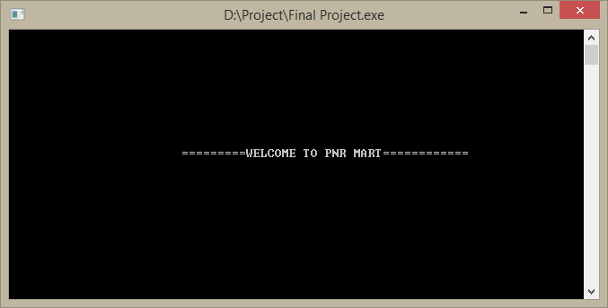
SAMPLE INPUT / OUTPUT

Slide 9
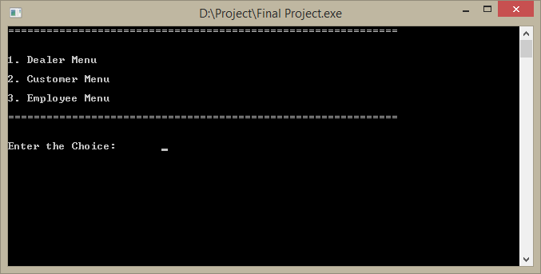
SAMPLE INPUT / OUTPUT

Slide 10
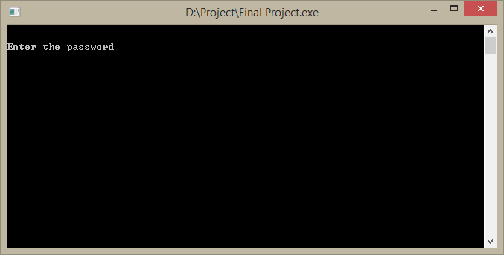
SAMPLE INPUT / OUTPUT

Slide 11

SAMPLE INPUT / OUTPUT

Slide 12
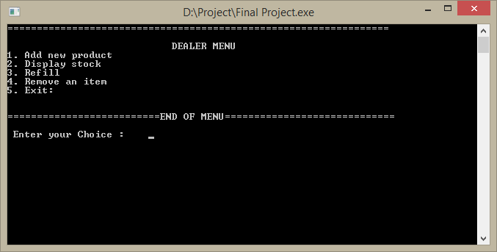
SAMPLE INPUT / OUTPUT

Slide 13
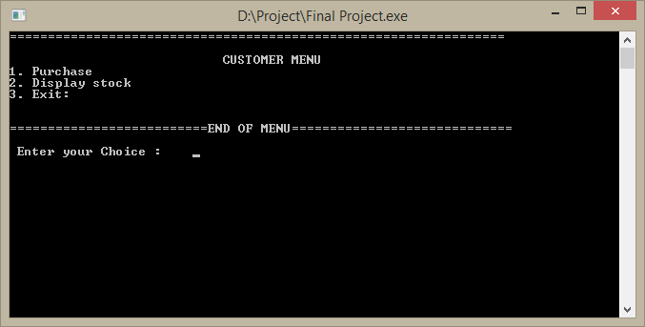
SAMPLE INPUT / OUTPUT

Slide 14
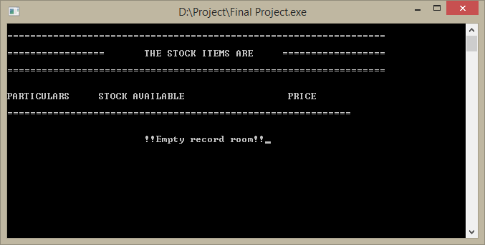
SAMPLE INPUT / OUTPUT

Slide 15
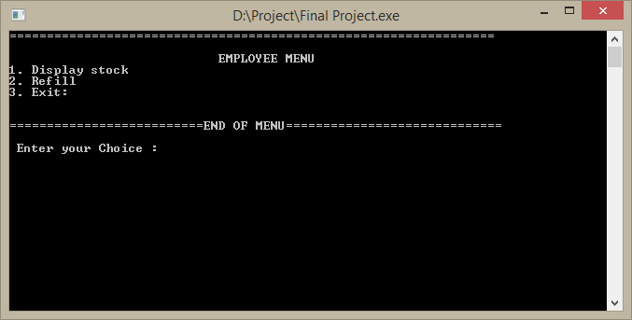
SAMPLE INPUT / OUTPUT

Slide 16
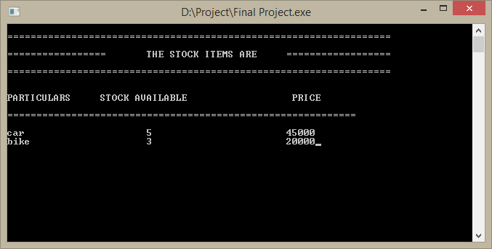
SAMPLE INPUT / OUTPUT

Slide 17
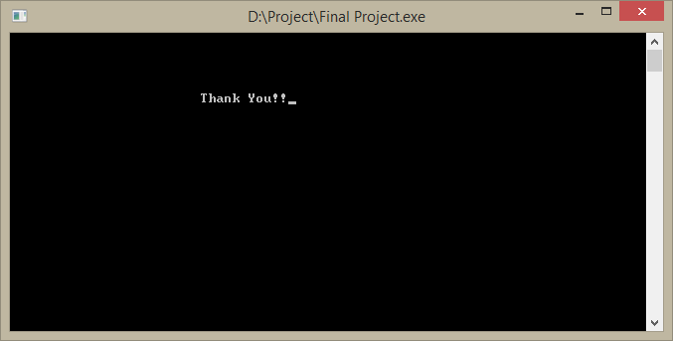
SAMPLE INPUT / OUTPUT
Thank You!!

Slide 18
COUT<<“THANK YOU!!”<<“:P”;
RETURN(25);

